Slide 1
Logistic Regression

Slide 2
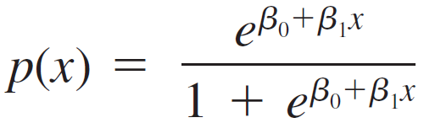
Logistic Regression
Whereas p(x) is a probability and therefore must be between 0 and 1, β₀ + β₁x need not be in this range.
Instead of letting the mean value of Y be a linear function of x, we now consider a model in which some function of the mean value of Y is a linear function of x.
In other words, we allow p(x) to be a function of β₀ + β₁x rather than β₀ + β₁x itself. A function that has been found quite useful in many applications is the logit function

Slide 3
Logistic Regression
Figure 13.8 shows a graph of p(x) for particular values of β₀ and β₁ with β₁ > 0.
A graph of a logit function
Figure 13.8

Slide 4
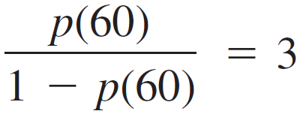
Logistic Regression
As x increases, the probability of success increases. For β₁ negative, the success probability would be a decreasing function of x.
Logistic regression means assuming that p(x) is related to x by the logit function. Straightforward algebra shows that
The expression on the left-hand side is called the odds.
If, for example, ,
then when x = 60 a success is three times as likely as a failure.

Slide 5
Example: Horse Shoe Crab Data
Some female crabs attract many males while others do not attract any. The males that cluster around a female are called “satellites.” In order to understand what influences the presence of satellite crabs, researchers selected female crabs and collected data on the following characteristics:
the color of her shell
the condition of her spine
the width of her carapace shell (in centimeters)
the number of male satellites
the weight of the female (in grams)
In today’s example, we will use the width of a female’s shell to predict the probability of her having one or more satellites. Let’s start by loading the data.
crabs<-read.csv(file.choose(),header=TRUE)
head(crabs)

Slide 6
Horseshoe Crab Data
To fit a regression model in r, we use the following command:
mod <- glm(y ~ width, family = binomial, data = crabs)
The first input is the regression formula (Response ~ Predictor), the second input indicates we have a binary response, and the third input is the data frame. To find the regression coefficients, we can use the coef command
coef(mod)
(Intercept) width
-12.3508177 0.4972306

Slide 7
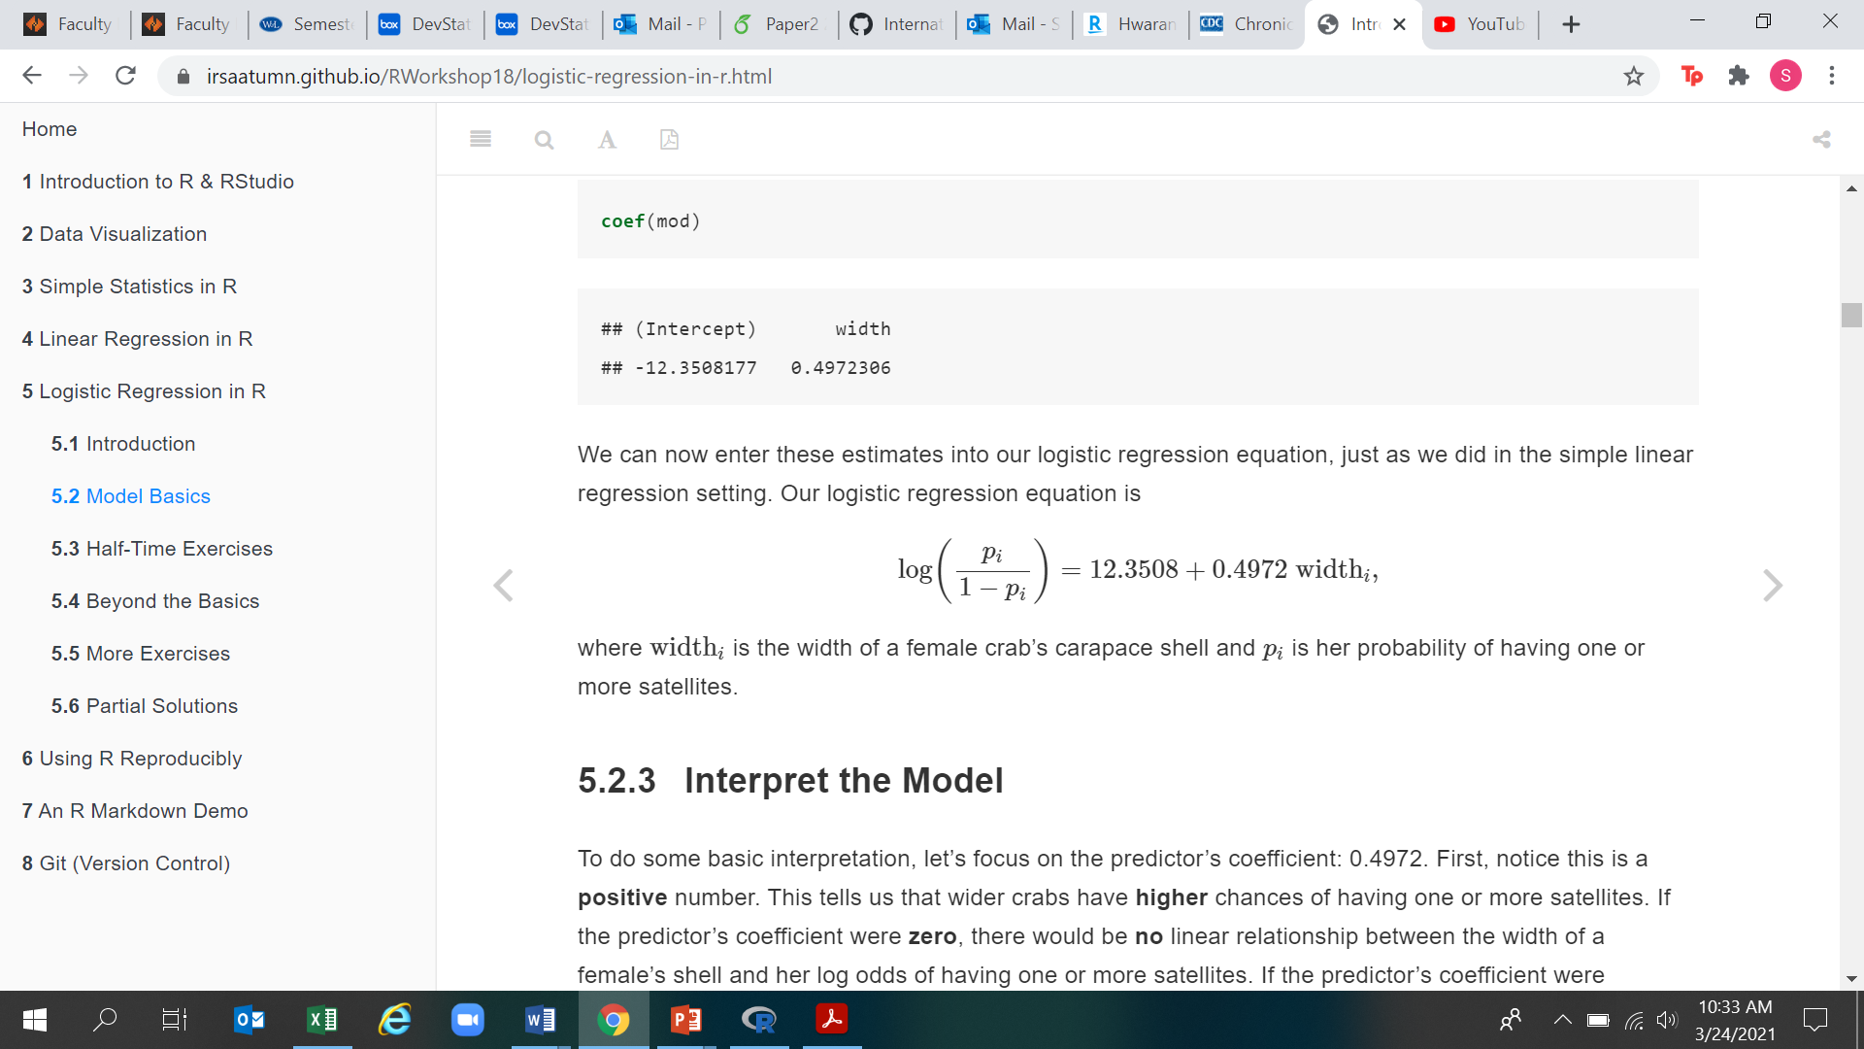
Horseshoe Crab Data
We now enter in these coefficients like we did with the linear model.

Slide 8
Interpret the model
To do some basic interpretation, let’s focus on the predictor’s coefficient: 0.4972.
First, notice this is a positive number. This tells us that wider crabs have higher chances of having one or more satellites.
If the predictor’s coefficient were zero, there would be no linear relationship between the width of a female’s shell and her log odds of having one or more satellites.
If the predictor’s coefficient were negative, then wider crabs would have lower chances of having one or more satellites.

Slide 9
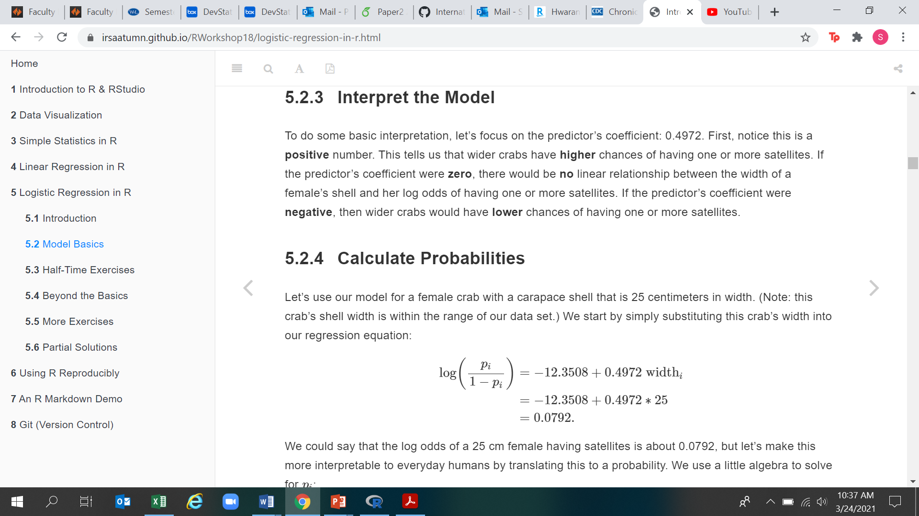
Calculate Probabilities
Let’s use our model for a female crab with a carapace shell that is 25 centimeters in width. We start by simply substituting this crab’s width into our regression equation:
We could say that the log odds of a 25 cm female having satellites is about 0.0792 but lets make it a little more interpretable

Slide 10
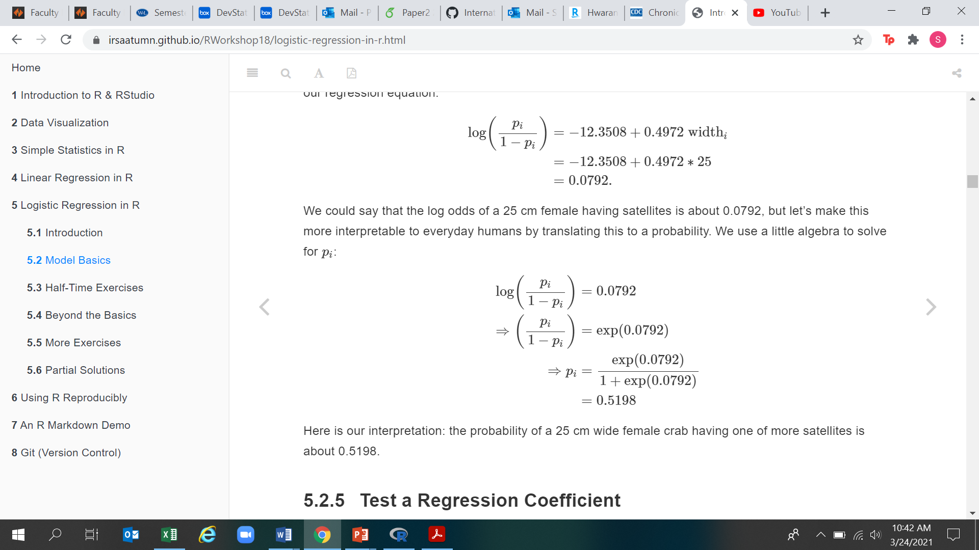
Calculate Probabilities

Slide 11
Test a Regression Coefficient
An essential question in regression is “Does this predictor actually help us predict the response?” In other words, we want to know whether there really is a relationship between our predictor and our response.
In the context of the crabs, we want to know whether the carapace width really does have a linear relationship with the log odds of satellites.
The null hypothesis is that her carapace width has no linear relationship to her log odds of having satellites.
The alternative hypothesis is that her carapace width has a linear relationship to her log odds of having satellites.
Remember: we assume there is no relationship until we find evidence that there is a relationship. That is, we assume that carapace width is unrelated to the probability of satellites; in order to say the carapace width is related to the probability of satellites, we need evidence. This evidence comes in the form of a statistical test.

Slide 12
Test a Regression Coefficient
summary(mod)
Call:
glm(formula = y ~ width, family = binomial, data = crabs)
Deviance Residuals:
Min 1Q Median 3Q Max
-2.0281 -1.0458 0.5480 0.9066 1.6942
Coefficients: Estimate Std. Error z value Pr(>|z|)
(Intercept) -12.3508 2.6287 -4.698 2.62e-06 ***
width 0.4972 0.1017 4.887 1.02e-06 ***
Signif. codes: 0 ‘***’ 0.001 ‘**’ 0.01 ‘*’ 0.05 ‘.’ 0.1 ‘ ’ 1
(Dispersion parameter for binomial family taken to be 1)
Null deviance: 225.76 on 172 degrees of freedom
Residual deviance: 194.45 on 171 degrees of freedom
AIC: 198.45
Number of Fisher Scoring iterations: 4

Slide 13
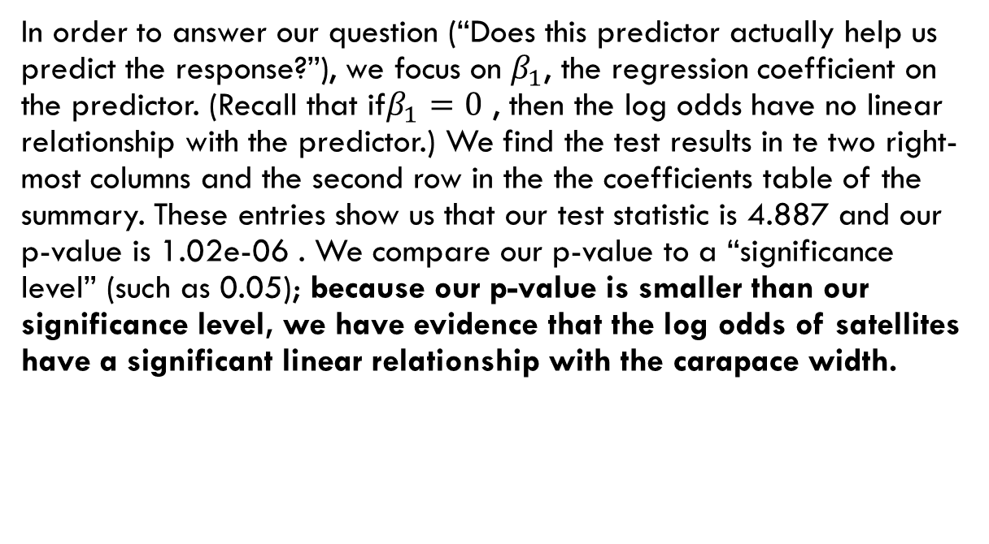
Test a Regression Coefficient
In order to answer our question (“Does this predictor actually help us predict the response?”), we focus on $β_{1}$, the regression coefficient on the predictor. (Recall that if$β_{1}=0$ , then the log odds have no linear relationship with the predictor.) We find the test results in te two right-most columns and the second row in the the coefficients table of the summary. These entries show us that our test statistic is 4.887 and our p-value is 1.02e-06 . We compare our p-value to a “significance level” (such as 0.05); because our p-value is smaller than our significance level, we have evidence that the log odds of satellites have a significant linear relationship with the carapace width.

Slide 14
Your Turn
Continue using the horseshoe crab data to investigate the relationship between a female’s weight and the log odds of her having satellites.
Create a logistic regression using the female’s weight as the predictor and whether she has satellites as the response variable.
Write down the regression equation.
Do heavier females having higher or lower chances of having satellites?
Consider a female weighing 2000 grams. What is the probability that she has one or more satellites?
Is there a linear relationship between a female crab’s weight and her log odds of satellites? Find the p-value and use a significance level of 0.05

Slide 15
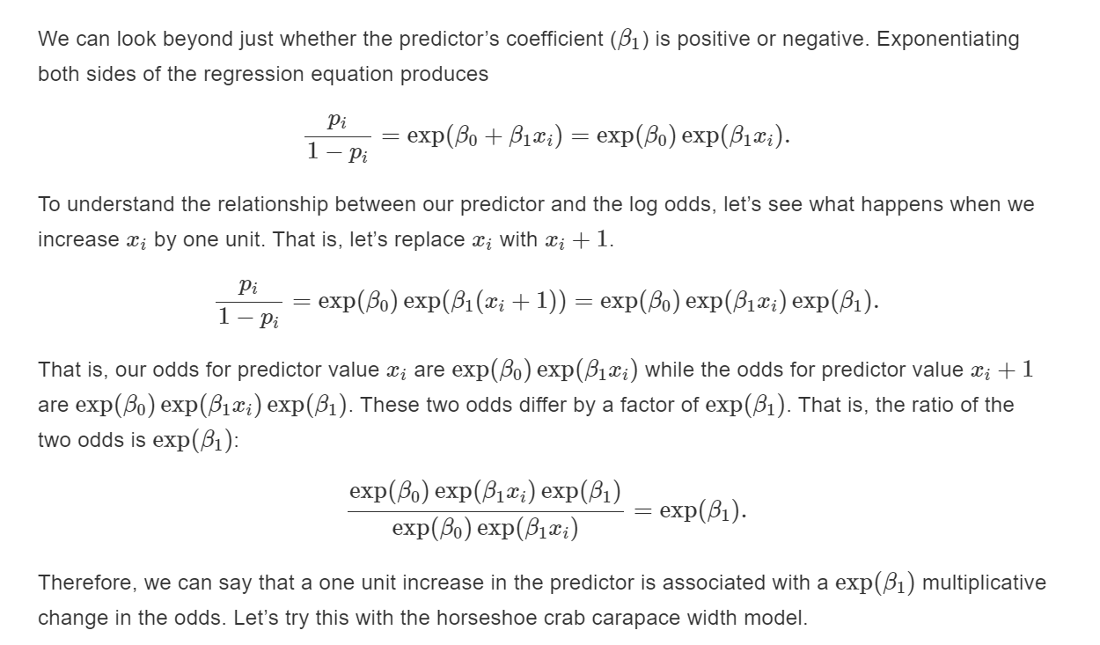
Interpret the model again

Slide 16
Interpret the model again
exp(coef(mod))
(Intercept) width
4.326214e-06 1.644162e+00
What does this mean?
A one centimeter increase in carapace width is associated with a 1.64 multiplicative change in the odds of having satellites. Alternatively, imagine two female crabs that have carapace widths that differ by exactly 1 cm. The odds of the larger crab having satellites is approximately 1.64 times the odds of the smaller crab having satellites.

Slide 17
Incorporate a categorical Predictor
Crabs were categorized according to whether they had two good spines (good), two worn or broken spines (bad), or one worn/broken spine and one good spine (middle).
spinemod <- glm(y ~ spine, data = crabs, family = binomial)
coef(spinemod)
(Intercept) spinegood spinemiddle
0.5955087 0.2646926 -0.7290401
This creates a model with a reference category spinebad
exp(coef(spinemod))
(Intercept) spinegood spinemiddle
1.8139535 1.3030303 0.4823718
>

Slide 18
Categorical Predictor
This model tells us that
the odds of satellites for a female with two bad spines is 1.8.
the odds of satellites for a female with two good spines is 1.3 times the odds of satellites for a female with two bad spines.
the odds of satellites for a female with one good spine and one bad spine is .48 times the odds of satellites for a female with two bad spines.

Slide 19
Alternate Interpretation
Sometimes people have a hard time interpreting odds ratios below 1. In this case, it is useful to flip the ratio.
1/exp(coef(spinemod))
(Intercept) spinegood spinemiddle
0.5512821 0.7674419 2.0730897
Therefore, we can reword the third bullet to the following: the odds of satellites for a female with two bad spines is 2 times the odds of satellites for a female with one bad spine and one good spine.

Slide 20
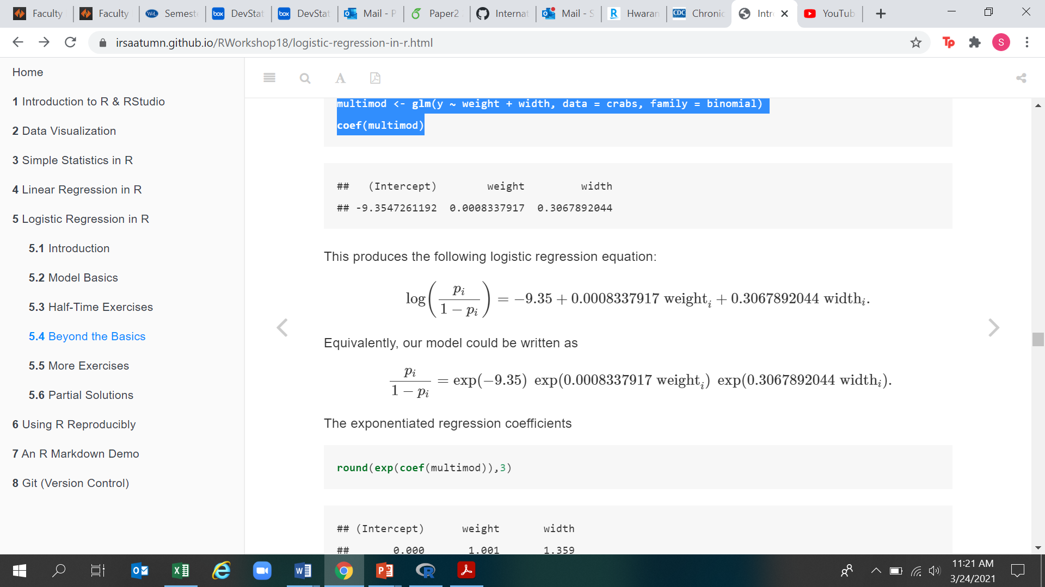
Multiple Predictors
multimod <- glm(y ~ weight + width, data = crabs, family = binomial)
coef(multimod)
(Intercept) weight width
-9.3547261192 0.0008337917 0.3067892044

Slide 21
Multiple Predictors
round(exp(coef(multimod)),3)
(Intercept) weight width
0.000 1.001 1.359
This tells us the following:
Holding weight constant, a one centimeter increase in carapace width is associated with a 1.359 multiplicative change in the odds of having satellites.
Holding carapace width constant, a one gram increase in weight is associated with a 1.001 multiplicative change in the odds of having satellites.
Of course, a one gram increase in weight is practically imperceptible. Let’s instead consider a 100 gram increase in weight.

Slide 22
Multiple Predictors
beta1 <- coef(multimod)[2]
exp(beta1 * 100)
weight
1.086954
Holding carapace width constant, a 100 gram increase in weight is associated with a 1.087 multiplicative change in the odds of having satellites

Slide 23
Inference
> summary(multimod)
Call:
glm(formula = y ~ weight + width, family = binomial, data = crabs)
Deviance Residuals:
Min 1Q Median 3Q Max
-2.1127 -1.0344 0.5304 0.9006 1.7207
Coefficients: Estimate Std. Error z value Pr(>|z|)
(Intercept) -9.3547261 3.5280465 -2.652 0.00801 **
weight 0.0008338 0.0006716 1.241 0.21445
width 0.3067892 0.1819473 1.686 0.09177 .
Signif. codes: 0 ‘***’ 0.001 ‘**’ 0.01 ‘*’ 0.05 ‘.’ 0.1 ‘ ’ 1
(Dispersion parameter for binomial family taken to be 1)
Null deviance: 225.76 on 172 degrees of freedom
Residual deviance: 192.89 on 170 degrees of freedom
AIC: 198.89
Number of Fisher Scoring iterations: 4

